Slide 1
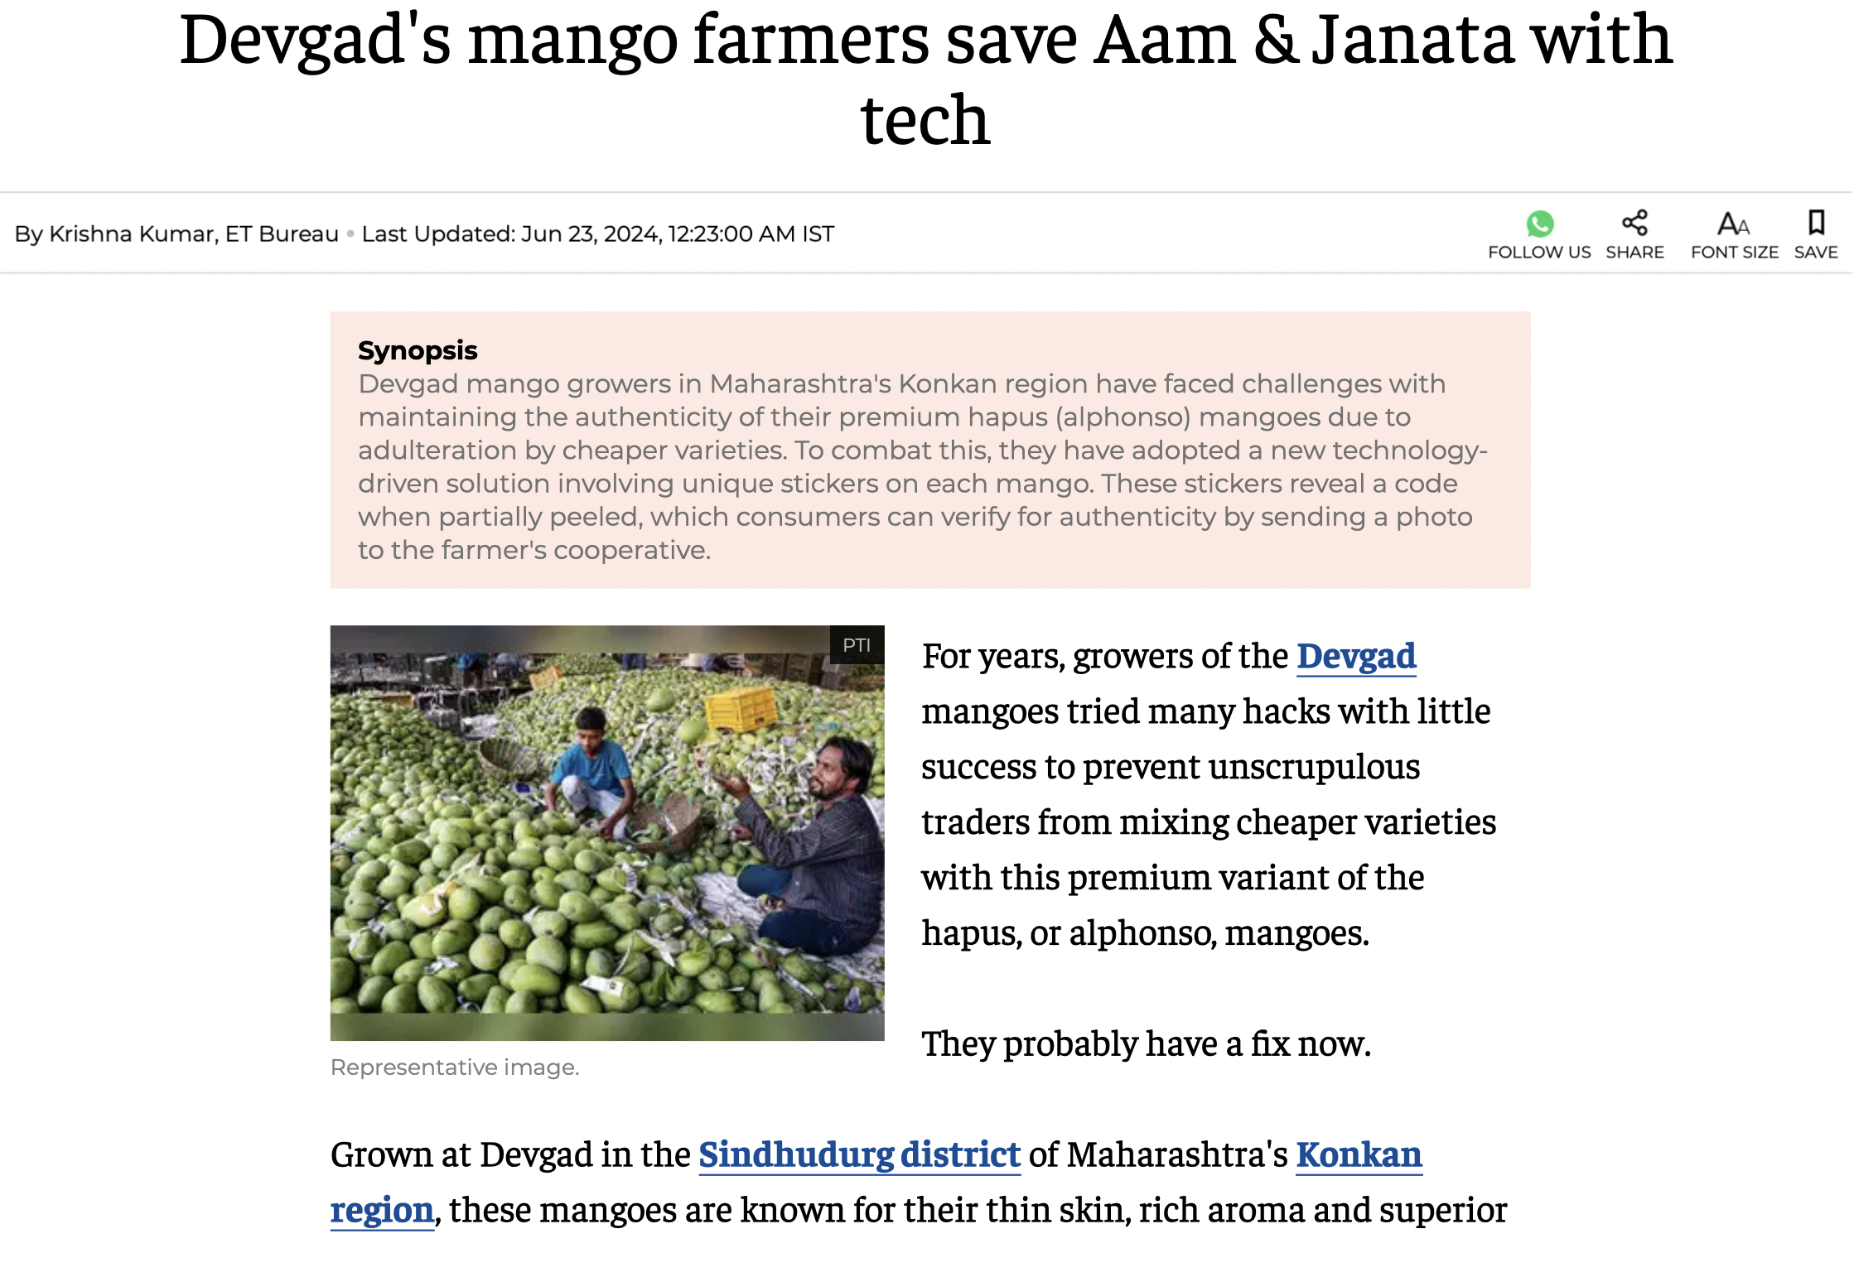

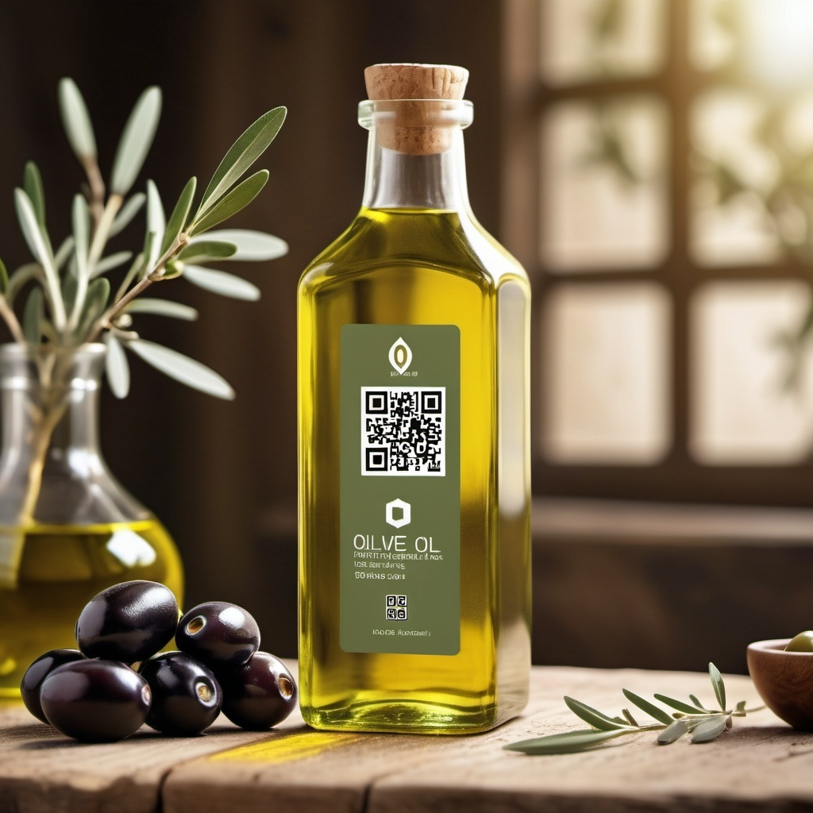
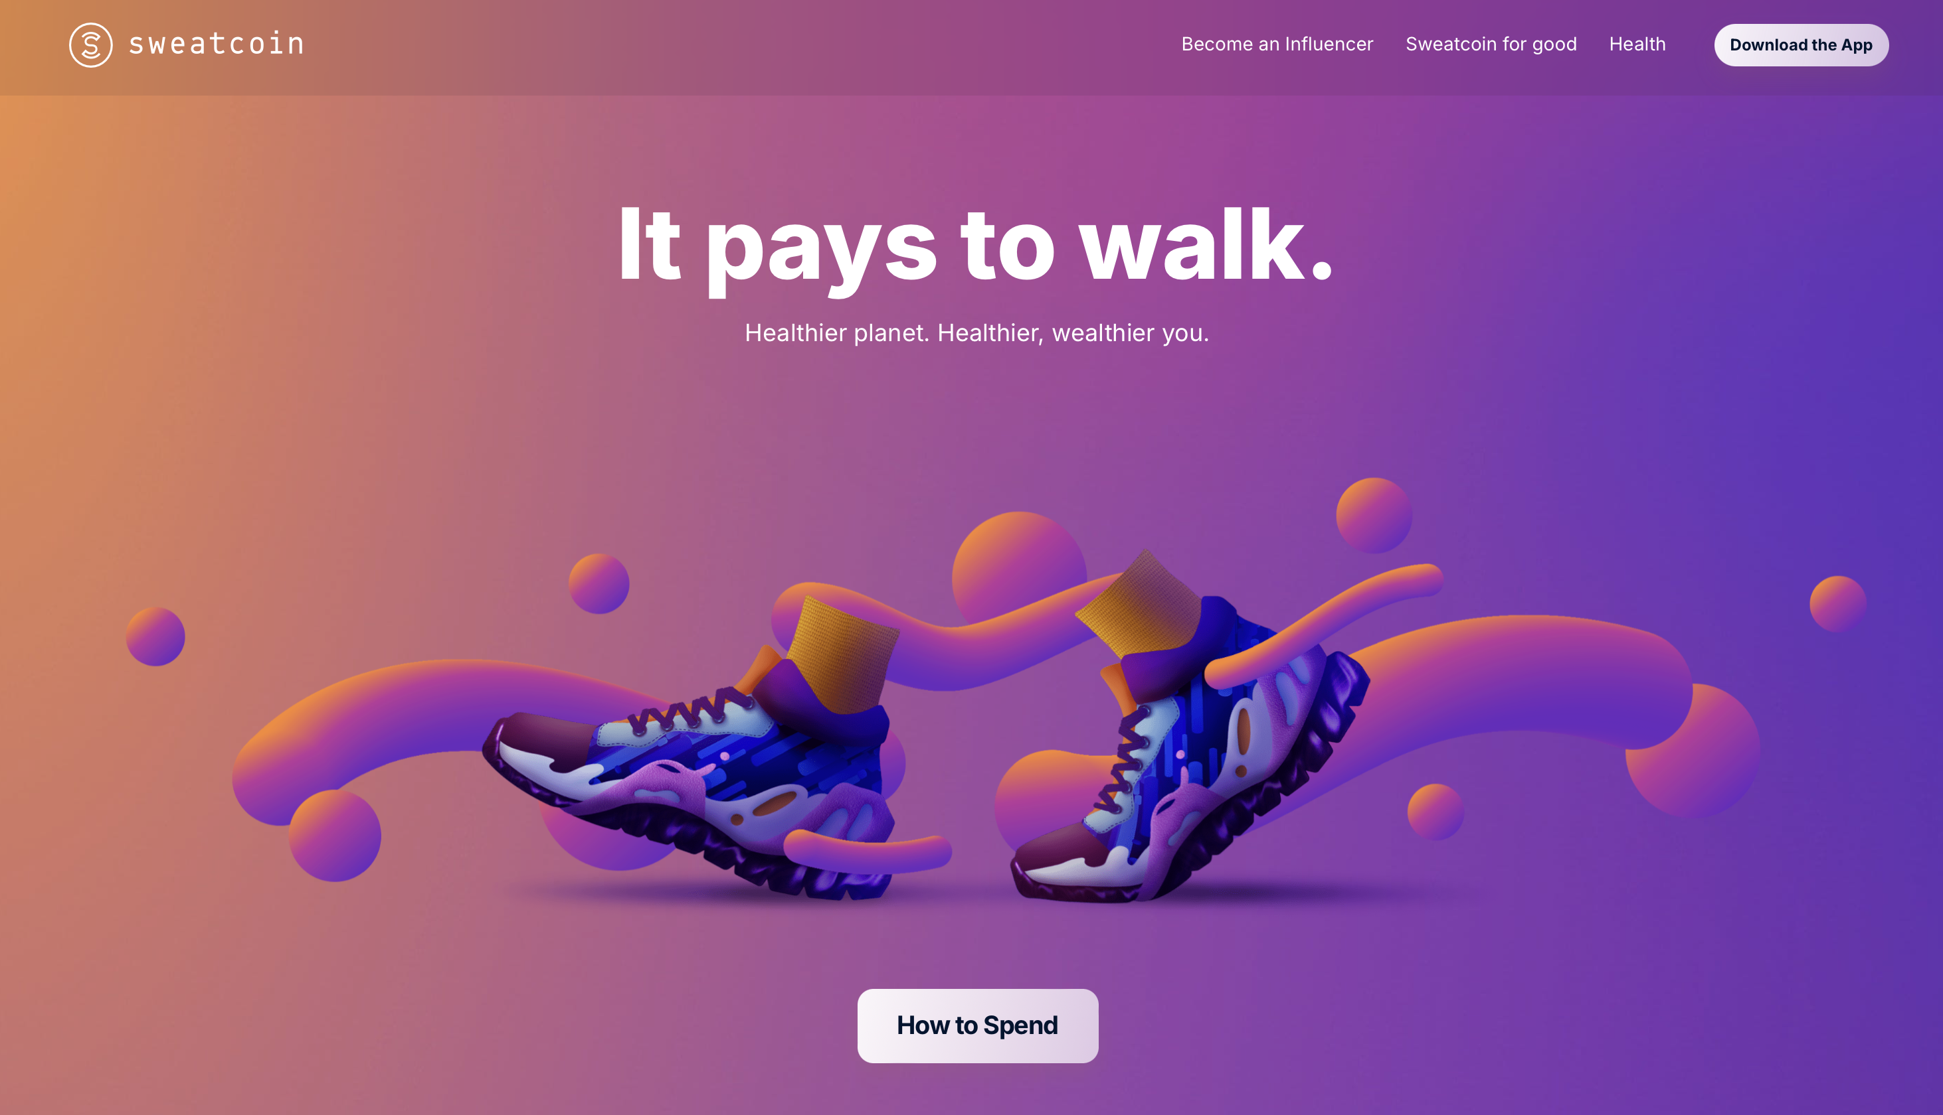

Slide 2

TrustBlu
Building Trust, Saving lives
Team Members
Nitu K Choudhary
Akshat Srivastava
Tushar Tiwari

Slide 3
Introduction
Inspiration: As dedicated blood donors, we noticed a gap in awareness and motivation for blood donation in Canada, despite existing efforts.
What it Does: TrustBlu is a blockchain platform that revolutionizes blood donation by incentivizing donors with NFTs, building their reputation, and enhancing social credit within the community.

Slide 4
The Challenges in Tissue Donation
Lack of Transparency and Auditability
Declining Participation
Supply Chain Risks

Slide 5
Solution
TrustBlu leverages public and private blockchains to create a transparent, secure, and incentivized tissue donation management system.
Focuses on improving both donor engagement and supply chain management through innovative technology.
Improves donor engagement and streamlines supply chain management.

Slide 6
Why TrustBlu?
Transparency: Ensures a clear and auditable process for tissue donations.
Incentivization: Encourages donations through rewards like Trust Tokens and NFTs.
Efficiency: Streamlines the supply chain, reducing waste and improving resource management.
Security: Protects sensitive medical data and ensures compliance with regulations.

Slide 7
Key Features
Blood Donation Incentivization: Rewards donors with utility tokens and NFTs.
Task and Reward System: Users earn rewards by completing specific tasks.
Admin Management Tools: Interface for admins to manage tasks, rewards, and user data.
More accountability and auditability by leveraging blockchain technology

Slide 8

Phase 1 – Accelerator
Introduction to Accelerator Phase: Marks the start of TrustBlu's mission to enhance donor awareness.
Incentives and Motivation: Recognition, social credit, and rewards can improve donor retention.
Community Building: Accelerator targets blood and plasma donations.
Loyalty System: Loyalty system on the Polygon network, incentivizing donors with Trust Tokens and NFTs to foster engagement and retention.

Slide 9
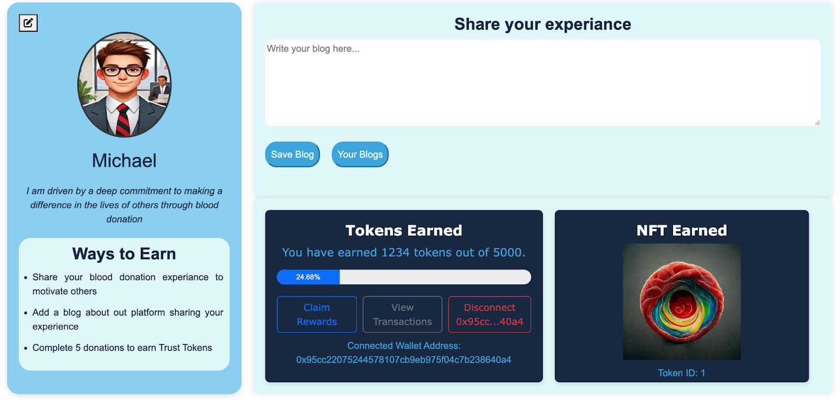
User Persona

Slide 10

Phase 2 and Hyperledger Fabric
Tracer Model Introduction
Challenges: Supply chain integrity, patient privacy, preventing fraud
Hyperledger Fabric's Role: secure, auditable blockchain solution, addressing
Benefits: Ensures security, transparency, and efficiency, making the Tracer model vital for modern healthcare.

Slide 11
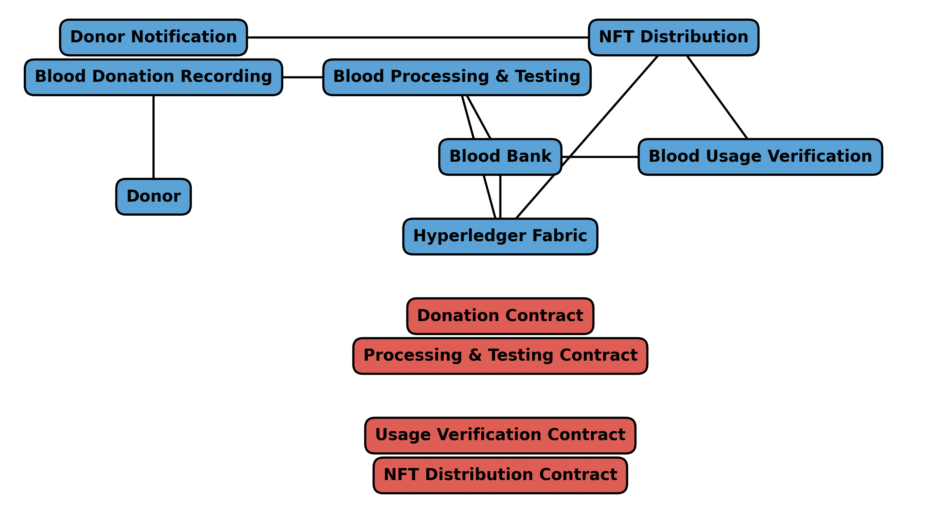
Phase 2 – The Tracer Model

Slide 12
Future Considerations
Advanced Analytics and Data Modeling: Implement analytics to gain insights into supply chain efficiency, donor behavior, and system performance.
Improved User Experience: Introduce new features to make the platform more intuitive and accessible.
AI-Powered Predictive Analytics: Optimize inventory management and reduce shortages using AI.
IoT Integration: Real-time tracking of blood transport conditions.

Slide 13
Questions
THANK YOU!

